Slide 1
Final Project
- Setting up new business in Toronto

Slide 2
Background
Toronto is the provincial capital of Ontario and the most popular city in Canada. It has a population of 2,731,571. Toronto is an international center of business, finance, arts and culture, and is recognized as one of the most multicultural and cosmopolitan cities in the world.
Problem
A business owner decides to open a restaurant where there is a lower real estate cost. At the same time, he may also want to choose the district according to population density. However, it is difficult to obtain information that will guide investors in the direction.

Slide 3
Data acquisition and cleaning
Data Sources
Neighbourhood, postal code and borough data can be found in Wikipedia page, https://en.wikipedia.org/wiki/List_of_postal_codes_of_Canada:_M, Data is cleaned and only Toronto area is selected.
The most common venues of given Borough of Toronto are found in Foursquare API.
The center coordinates of each Borough are found from https://cocl.us/Geospatial_data

Slide 4
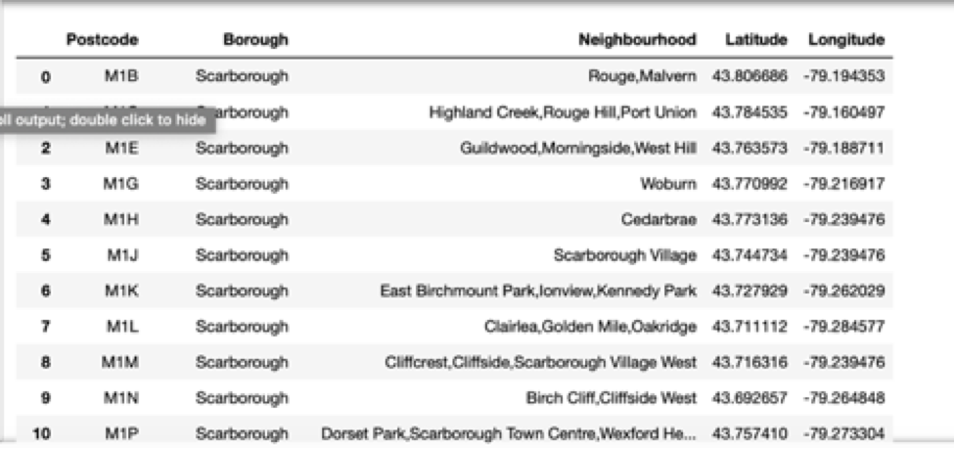
Data Visualization
As a database, I used GitHub repository in my study. My master data which has the main components Postcode, Borough, Neighbourhood, Latitude and Longitude information of the city.

Slide 5
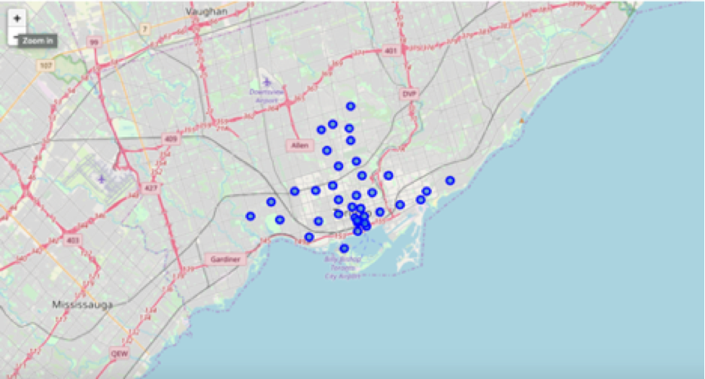
Data Visualization
To visualize geographic details of Istanbul and its boroughs, python folium library is used. A map of Toronto with boroughs are marked on the graph. I used latitude and longitude values to get the visual as below:

Slide 6
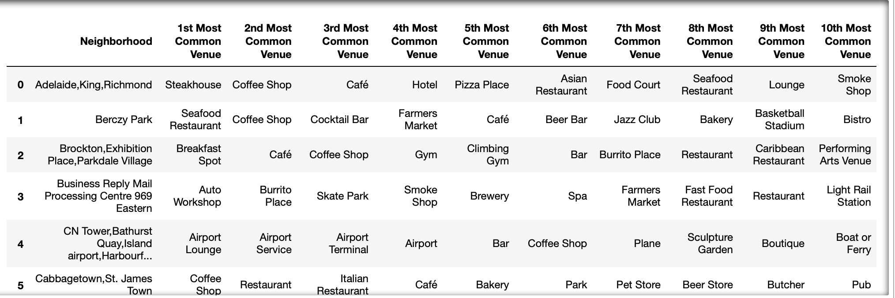
10 Most Common Venues
Then analysis made on 10 most common venues for each Neighbourhood, for example, places like CN Tower are mainly served for Airport services.

Slide 7
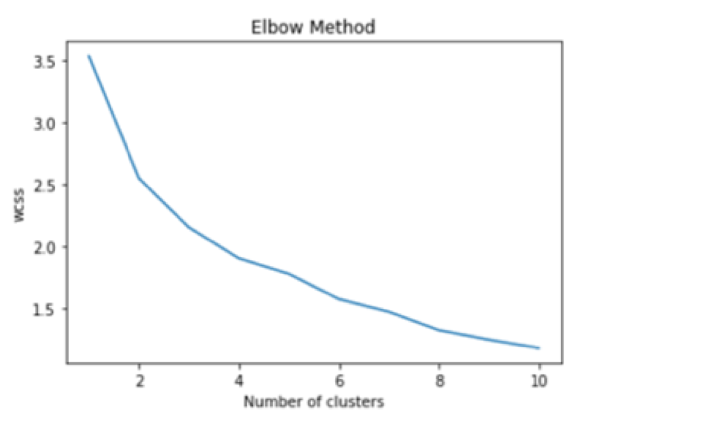
K-means Clustering
Elbow Method

Slide 8
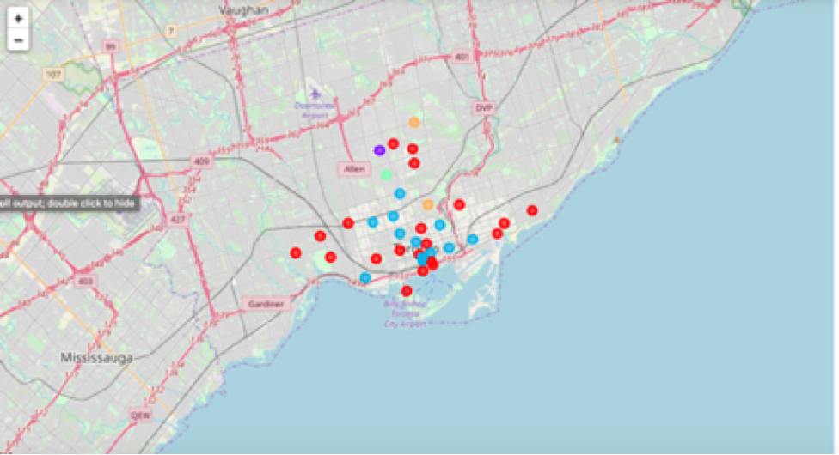
Clustered Map of Toronto (Red Points)

Slide 9
Thank you!

